Slide 1
CDR and SRM graphics
Please look at the first 3 slides on SRM. Write any thoughts or feedback directly in the slides.
The existing CDR graphics are provided for reference. At some later point we might expand the deck to:
Harvested wood products
Ecosystem/peatland restoration
A better one for ocean fertilization that doesn’t look like blue carbon
SRM - Cirrus cloud thinning
SRM - Ice protection
SRM - Surface based albedo modification
Any others that might be useful? Let me know

Slide 2

SRM- Stratospheric aerosol injection
Remove or soften blur at bottom of figure (hurts my eyes)

Slide 3

SRM – Marine cloud brightening
More futuristic ship

Slide 4

SRM – Space mirrors
Looks good!

Slide 5
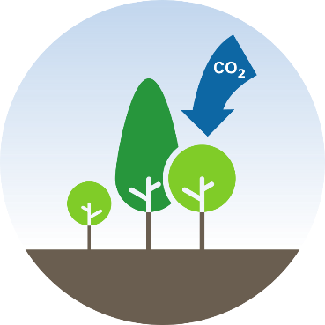
Afforestation

Slide 6
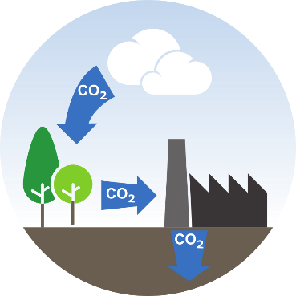
BECCS

Slide 7
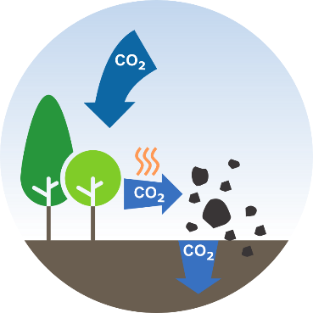
Biochar

Slide 8
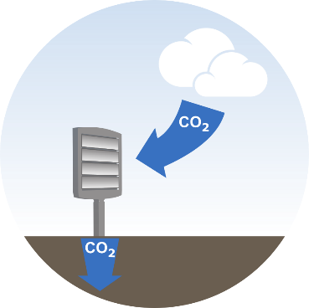
DACCS

Slide 9
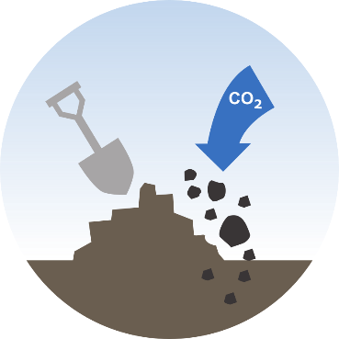
Enhanced weathering

Slide 10
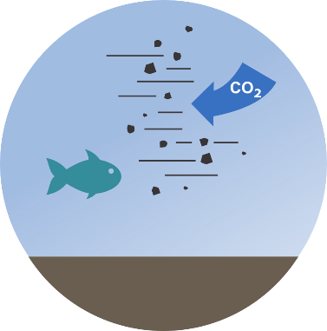
Ocean alkalinisation

Slide 11
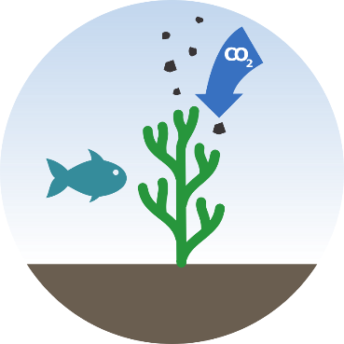
Ocean fertilisation

Slide 12
Blue carbon

Slide 13
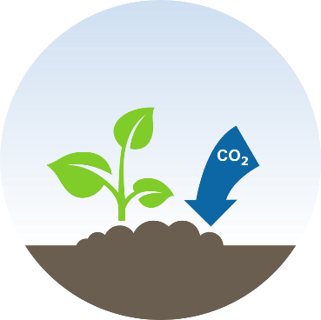
Soil carbon sequestration

